Slide 1
Software Engineering

Slide 2

Outline
2
SDLC Models
Sequential Model
▫ Waterfall Model
▫ V-Model

Slide 3

SDLC Models
3
Sequential model
  Waterfall model.
  V-model
Incremental model
  Incremental model.
  Spiral model
  RAD (Rapid application development) model

Slide 4

When to use the V-Shaped Model
4
Excellent choice for systems requiring high reliability – hospital patient control applications
When it can be modified to handle changing requirements beyond analysis phase
Solution and technology are known
Small to medium sized projects where requirements are clearly defined and fixed.
Sufficient technical resources are available with needed technical expertise.
High confidence of customer is required.
▫ Since, no prototypes are produced, there is a very high risk involved in meeting customer expectations.

Slide 5

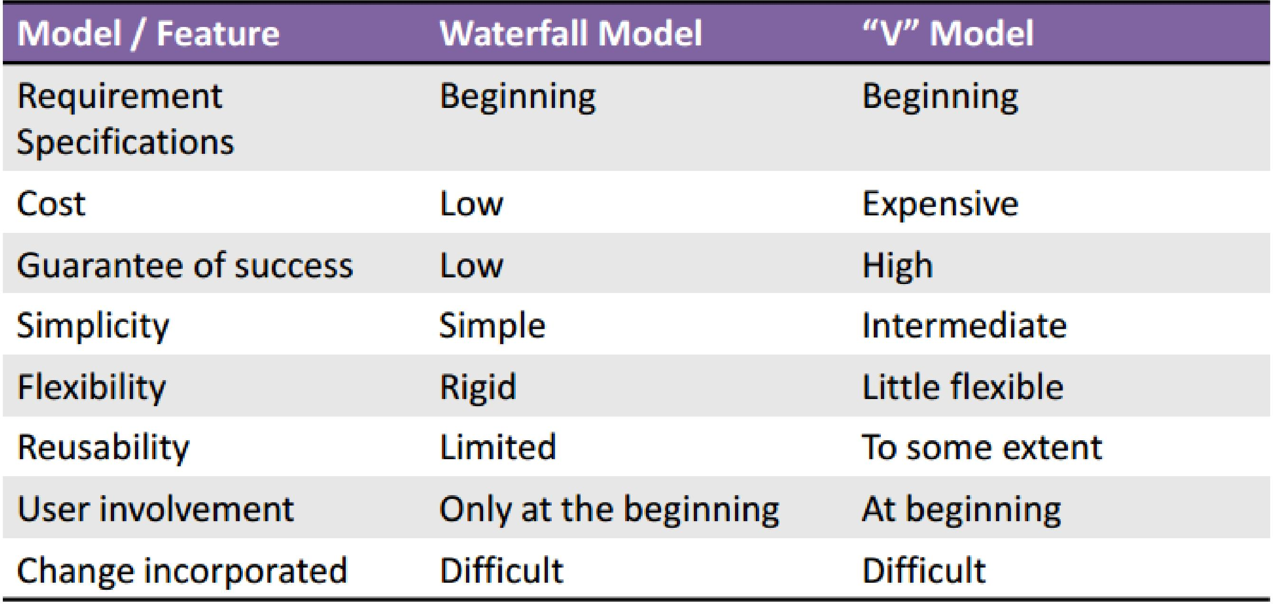
Waterfall Model Vs. V Shaped Model
5

Slide 6

Problem Scenario
6
We received a requirement specification from a client for developing a solution for their specified problem in a domain we have little or no expertise and obviously no experience of developing similar solution.

Slide 7

Problem Scenario
7
Example A: In “Waterfall Model”
This Model is not suitable for using it in this case. Because :
▫ Clients may not know the complete vision of the solution .
▫ No expertise and experience on this domain which reflect that we can’t gather complete requirements, and that leads for troubles due new findings.

Slide 8

Problem Scenario
8
Example A: In “V” Model
This is not suitable for using it in this case because:
▫ It is similar to “Waterfall” model except of the added test phases at each level, so gathering will be an issue here too.
▫ No working prototype will be available because there is not any incremental/ modular/ iterative approach.

Slide 9

This is my Question?
9
We received a requirement specification from a client for developing a solution for their specified problem in domain. We have expertise and experience of developing similar solutions
What model we will use?

Slide 10

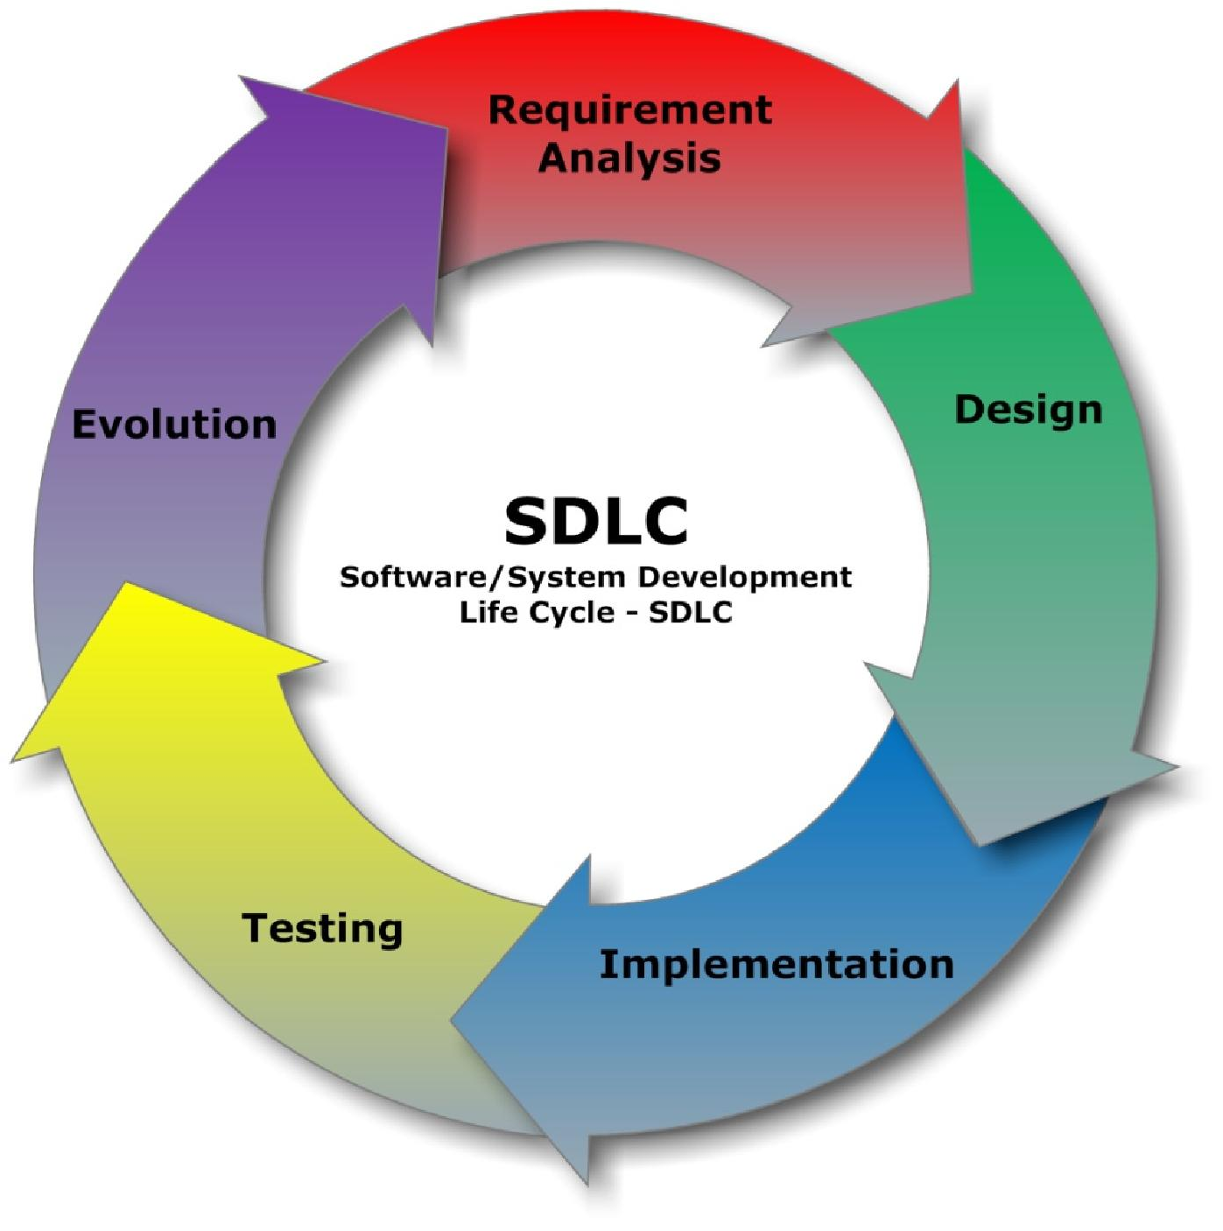
Evolutionary Development
10

Slide 11

Evolutionary Development
Evolutionary development is an iterative and incremental approach to software development.
Instead of creating a comprehensive artifact, such as a requirements specification, that you review and accept before creating a comprehensive design model, you instead evolve the critical development artifacts over time in an iterative manner.

Slide 12
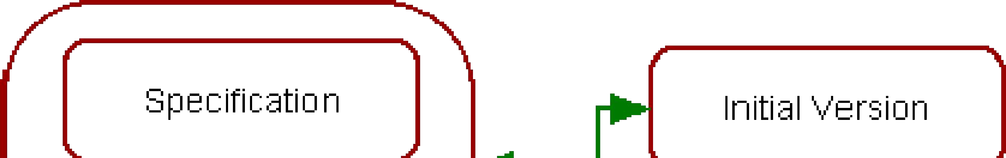
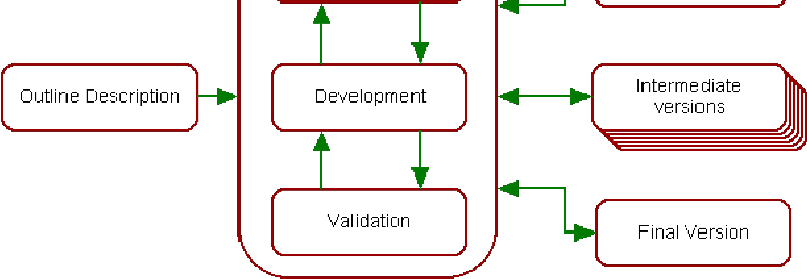
Evolutionary Development Model
Develop an initial implementation, expose to users comments, refine until satisfied

Slide 13
Prototyping
Instead of directly building the final system we first build a prototype (a rough, incomplete, working model).
Clarify requirements
Early feedbacks
Reduce misunderstandings

Slide 14
Prototyping
When to use:
Requirements are not clear or are changing frequently.
Users don’t know exactly what they want until they “see something”.
Best for projects with high user interaction (websites, apps, customer-facing systems).
Deals with Fuzzy Requirements.
  e.g: “We need something user-friendly.”
  “Make it fast and modern.” “
  I’ll know it when I see it.”

Slide 15

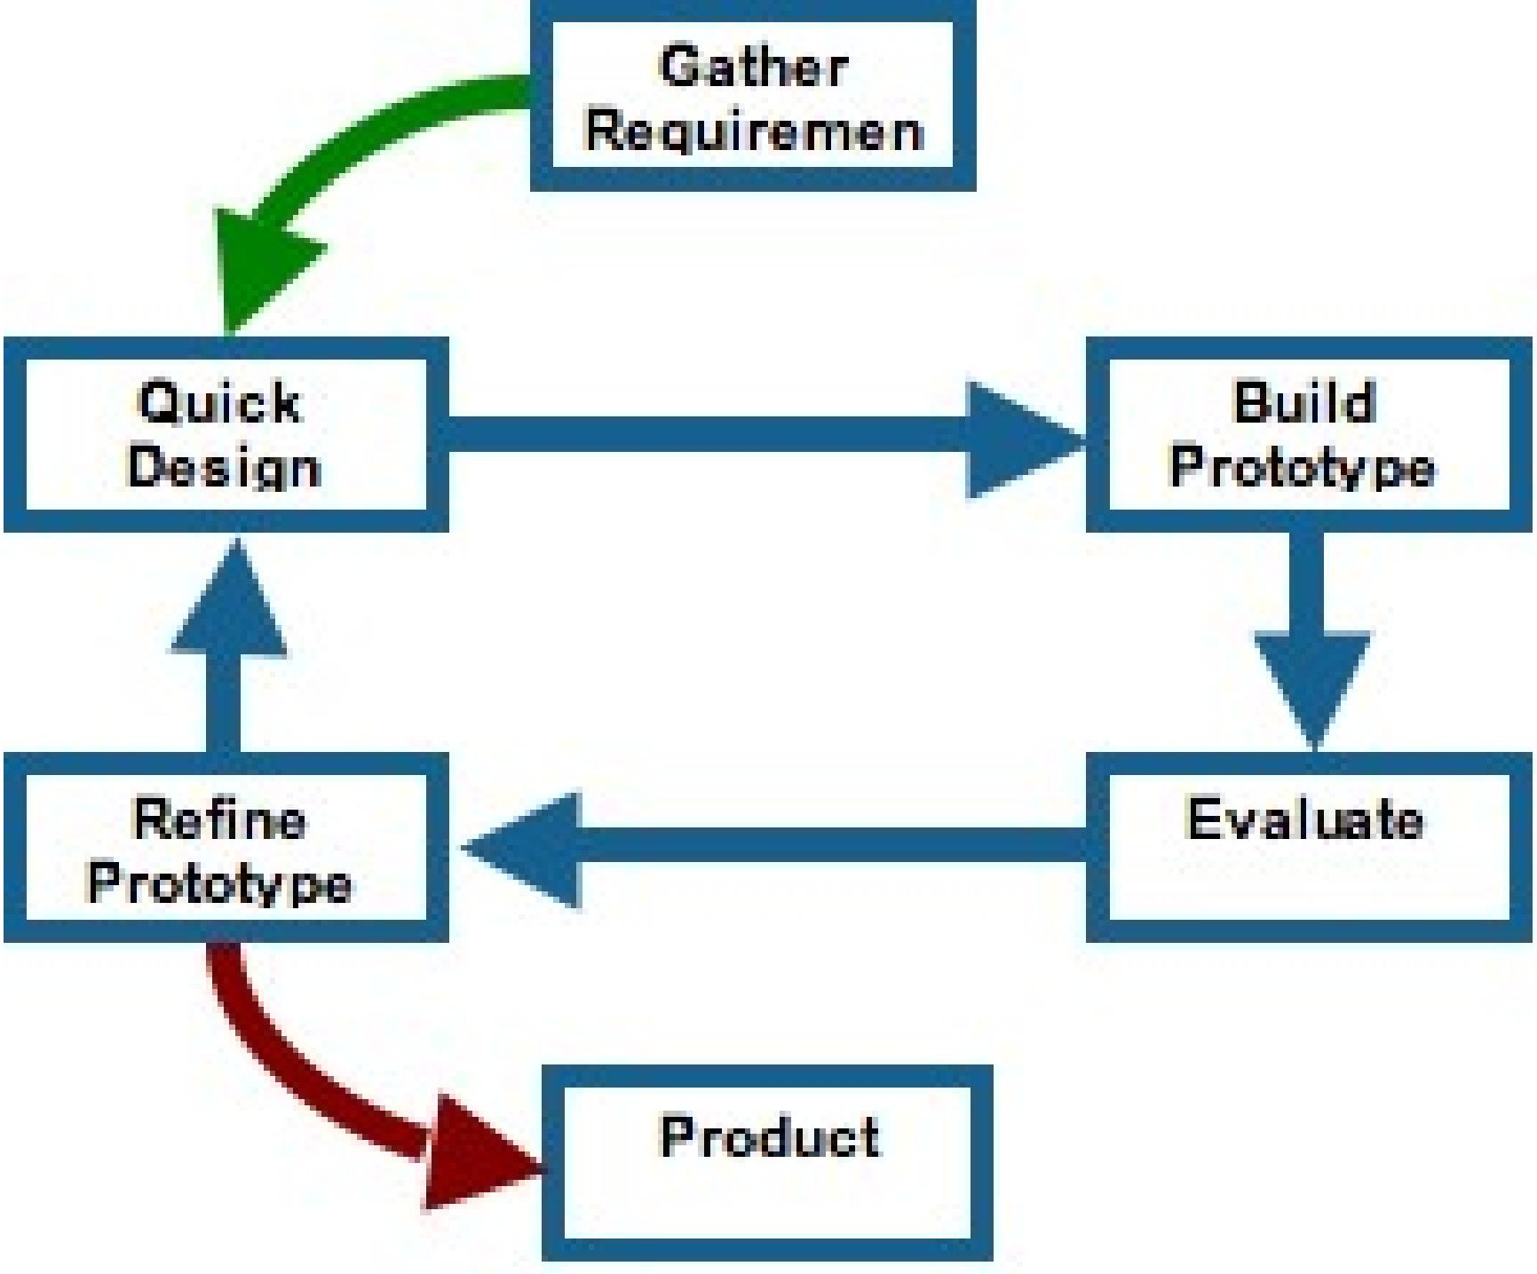
Prototyping

Slide 16

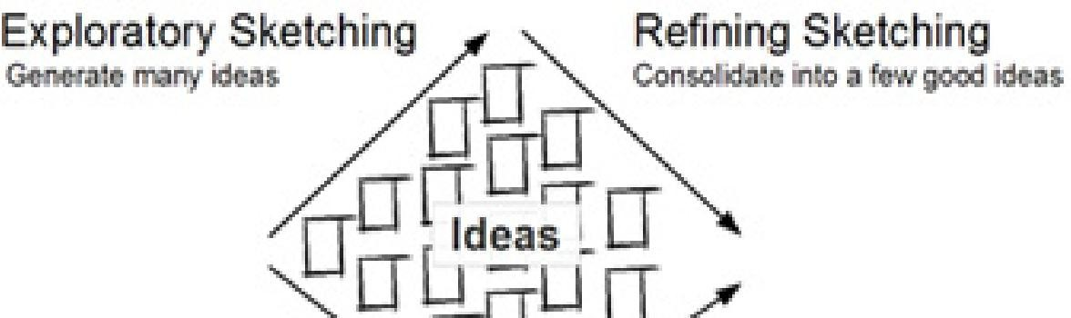
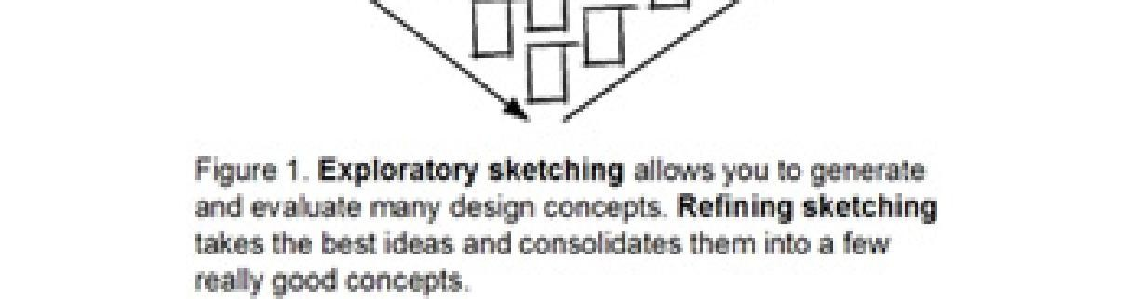
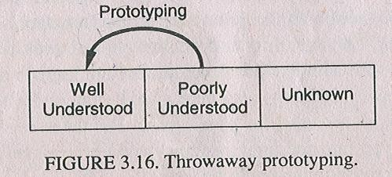
Evolutionary development types
There are two types of evolutionary development:
Exploratory prototyping
▫ Start with requirements that are well defined
▫ Add new features when customers propose new requirements
Throw-away prototyping
▫ Objective is to understand customer’s requirements (i.e. they often don’t know what they want, hence poor requirements to start)
▫ Use means such as prototyping to focus on poorly understood requirements, redefine requirements as you progress

Slide 17

Problems and Applicability
Applicability
▫ For small or medium-size systems
▫ For parts of large systems (e.g. the user interface)
Problems
▫▫ Systems are often poorly structured
▫ Special skills (e.g. in languages for rapid prototyping) may be required

Slide 18

Advantages of evolutionary development model:
Happier customers since you help them define requirements
Flexibility in modifying requirements
Prototypes are very visual, hence no ambiguities
Specifications can be developed incrementally
This model is very appropriate for research projects. For example, to develop software for automatic speech recognition, a small vocabulary can be taken and the system is developed. After achieving success, the vocabulary can be increased in stages. This approach is better than starting development of an unlimited vocabulary speech recognition system directly (and after two years, realizing that it is very difficult!).

Slide 19

Disadvantages of evolutionary development model:
Because the project is open-ended, no time frame can be set.
Project monitoring is difficult.
Hard to trace the “process” due to the ad-hoc nature

Slide 20

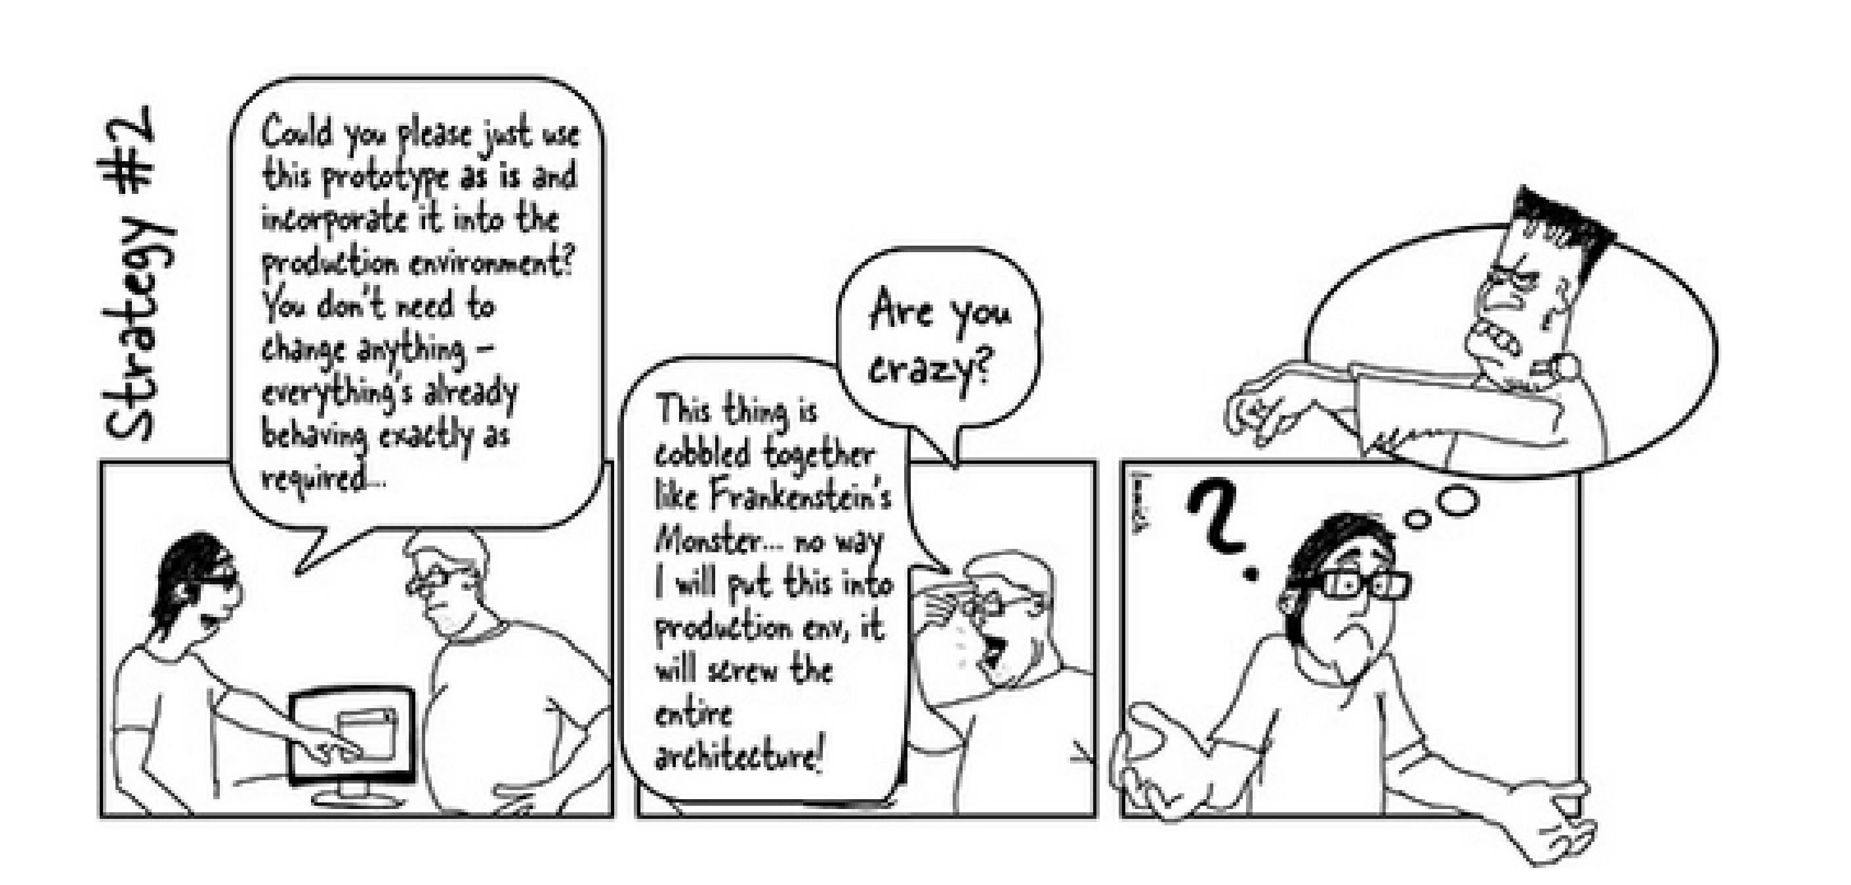
Problem while designing prototype

Slide 21
Incremental
Model

